Slide 1

Varendra University
Dept. of Computer Science & Engineering (CSE)
Microprocessor
Course Title: Microprocessor and Assembly Language
Course No: CSE 3205
Prepared By:
Md. Adnan Sami
Lecturer, Dept. of CSE, VU

Slide 2
Outline
Generation of Microprocessor.
8080/8085 Microprocessor.
8086 Microprocessor.
Difference between 8085 and 8086 Microprocessor.
Pipelining.
What is 16-bit processor?

Slide 3
Generation of Microprocessor
First Generation (Between 1971 – 1973)
PMOS technology.
4 bit processors (16 pins).
8 and 16 bit processors (40 pins).
Second Generation (During 1973)
NMOS technology.
Faster speed, Higher density.
4 / 8/ 16 bit processors (40 pins).
Intel 8085 (8 bit processor).

Slide 4
Generation of Microprocessor
Third Generation (During 1978)
HMOS technology.
Faster speed, Higher packing density.
16 bit processors (40/ 48/ 64 pins)
Easier to program.
Dynamically relatable programs.
Intel 8086 (16 bit processor).

Slide 5
Generation of Microprocessor
Fourth Generation (During 1980)
HCMOS technology.
32 bit processors.
Physical memory space 224 bytes = 16 Mb.
Virtual memory space 240 bytes = 1 Tb.
Intel 80386.
Fifth Generation
Pentium.

Slide 6
Generation of Microprocessor
Pentium (1993)
32 bit microprocessor.
64 bit data bus.
32 bit address bus.
4 GB main memory.
60,66,90 MHz.
Pentium Pro (1993)
32 bit microprocessor.
64 bit data bus.
36 bit address bus.
64 GB main memory.
Starts at 150 MHz.
Pentium II (1997)
32 bit microprocessor.
64 bit data bus.
36 bit address bus.
64 GB main memory.
Starts at 266 MHz.
Pentium III (1999)
32 bit microprocessor.
64 bit data bus.
36 bit address bus.
64 GB main memory.
Starts at 450 MHz.

Slide 7
Generation of Microprocessor
Pentium IV (2002)
32 bit microprocessor.
64 bit data bus.
32 bit address bus.
4 GB main memory.
Starts at 1.4 GHz.

Slide 8
Generation of Microprocessor

Slide 9
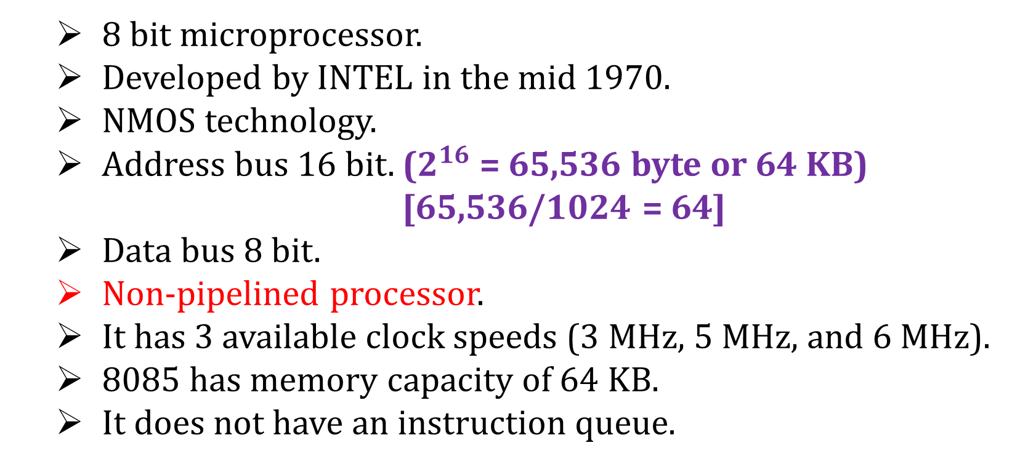
8080/8085 Microprocessor
8 bit microprocessor.
Developed by INTEL in the mid 1970.
NMOS technology.
Address bus 16 bit. ($2^{16}$ = 65,536 byte or 64 KB)
[65,536/1024 = 64]
Data bus 8 bit.
Non-pipelined processor.
It has 3 available clock speeds (3 MHz, 5 MHz, and 6 MHz).
8085 has memory capacity of 64 KB.
It does not have an instruction queue.

Slide 10
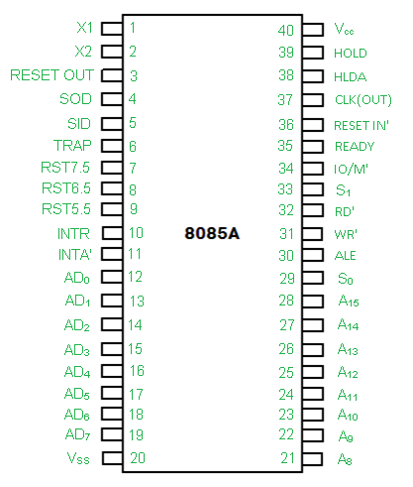
8080/8085 Microprocessor
Pin diagram of 8085 microprocessor.

Slide 11
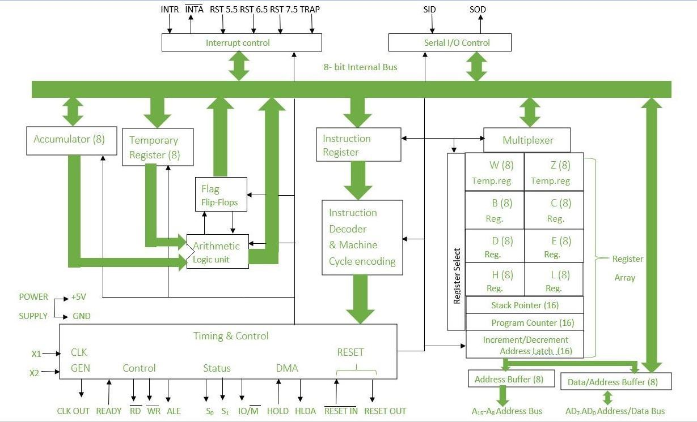
8080/8085 Microprocessor

Slide 12
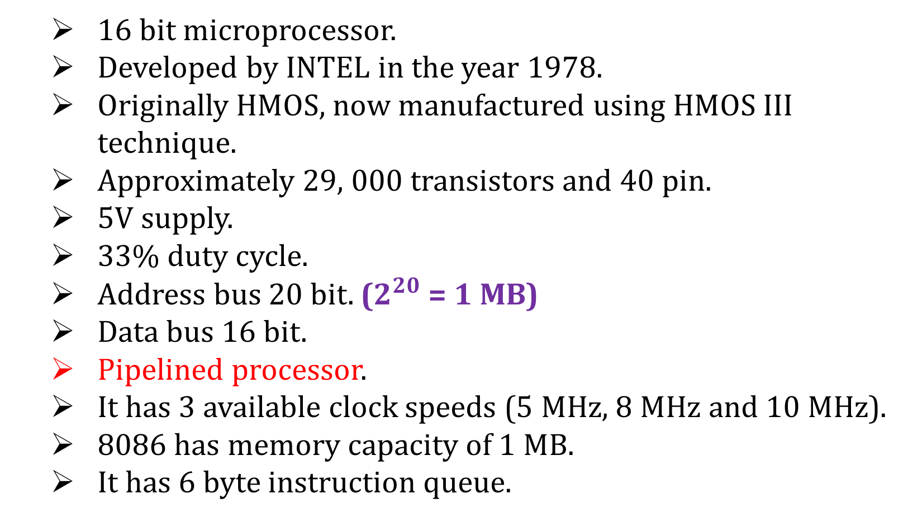
8086 Microprocessor
16 bit microprocessor.
Developed by INTEL in the year 1978.
Originally HMOS, now manufactured using HMOS III technique.
Approximately 29, 000 transistors and 40 pin.
5V supply.
33% duty cycle.
Address bus 20 bit. ($2^{20}$ = 1 MB)
Data bus 16 bit.
Pipelined processor.
It has 3 available clock speeds (5 MHz, 8 MHz and 10 MHz).
8086 has memory capacity of 1 MB.
It has 6 byte instruction queue.

Slide 13
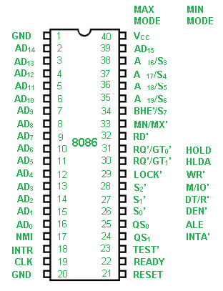
8086 Microprocessor
Pin diagram of 8086 microprocessor.

Slide 14
Difference between 8085 and 8086 Microprocessor
8085 | 8086
8 bit microprocessor. | 16 bit microprocessor.
Address bus 16 bit. | Address bus 20 bit.
Data bus 8 bit. | Data bus 16 bit.
Non-pipelined processor. | Pipelined processor.
Memory capacity 64 KB. | Memory capacity 1 MB.
NMOS technology. | HMOS III technology.

Slide 15
Pipelining
The process of fetching the next instruction when the present instruction is being executed is called as pipelining.
Non-pipelined:
Fetch 1 | Execute 1 | Fetch 2 | Execute 2 | Fetch 3 | Execute 3
Pipelined:
Fetch 1 | Execute 1
Fetch 2 | Execute 2
Fetch 3 | Execute 3

Slide 16
Pipelining
Advantage of pipelining:
Requires less time.
Speed fast.
Efficiency is more.

Slide 17
What is 16-bit processor
A processor that can process 16-bit data at a time is called a 16-bit processor.

